Slide 1
Rice Exports Data Analysis
By
Sabiullah N

Slide 2
Problem Statement
Analyzing the trends in rice exports to identify patterns with volumes.
Understanding Top Players in the market who contributes more shares.
Assessing the Year wise trend among countries and exporters.

Slide 3
Tools used
Python
Pandas
MySQL
Streamlit
Plotly

Slide 4
Approaches
Data Extraction and Concatenation:
Extraction of CSV files from the zip folder using zipfile.ZipFile and combining them into a single DataFrame using pd.concat.
Filtering out unnecessary columns which are having more null values and keep the columns only those having data.
Standardizing Quantity Units:
Identified different units in the 'QUANTITY UNIT' column and mapped various similar units to a standardized set of units ('KGS', 'MTS', 'LBS', 'QTL').
Used replace() function to unify the units to a standardized form.
Calculation of Quantity in Kilograms (QTY IN KG):
Defined a function calculate_qty() to convert quantities into a single unit (kilograms) based on the mapping created earlier.
Applied the function to create a new column 'QTY IN KG' containing the quantities in kilograms.
4. Handling Missing Values:
Removed rows with missing values in the 'QUANTITY UNIT' column using dropna() function to ensure accurate calculations.
Dropped the 'IMPORT VALUE CIF' column as it wasn't necessary for further analysis.

Slide 5
Approaches
5. Outlier Detection and Removal:
Calculated quartiles (Q1, Q3) and Interquartile Range (IQR) to identify outliers in the 'QTY IN KG' column.
Detected outliers based on the IQR and removed them from the dataset.
6. Data Transformation:
Cleaned the 'IMPORTER NAME' column by removing unnecessary characters using str.replace().
7. Feature Engineering:
Converted 'ARRIVAL DATE' to a datetime format and created a new 'Month' column to extract the month information.
Mapped month numbers to month names in a new 'Month Name' column for better readability.
8. Data Storage:
Used MySQL connector and SQLAlchemy to establish a connection to a MySQL database.
Created a connection string and added the cleaned data to the 'ricedata' table in the 'riceexports' database using to_sql() method.

Slide 6
Summary of Key Insights
Import Overview
The analysis provided a comprehensive view of import data, revealing notable trends and patterns in the inbound trade of rice. However, limitations in data availability regarding CIF, currency conversion, and monthly granularity restricted a deeper understanding of import dynamics.
Export Overview
Similarly, the examination of export data offered valuable insights into outbound trade patterns. Yet, the absence of critical information such as CIF, currency conversion, and monthly data hindered the ability to forecast export trends and assess correlations among countries and importers over varying months.
Port of Arrival / Departure Overview
The analysis of port-specific data shed light on arrival and departure trends. However, the absence of CIF information limited the comprehensive understanding of the influence of insurance and freight in inter-country trade.

Slide 7
Summary of Key Insights
Geographical Analysis
Geographic insights provided valuable context, yet the absence of crucial data elements like CIF and currency conversion constrained the ability to predict trends and derive correlations among countries based on varying months.
Product Analysis
The analysis offered insights into product-specific trends. Nevertheless, the lack of CIF data restricted the capability to predict average rates of each product, limiting the assessment of trends associated with rate fluctuations.
Financial Analysis
The analysis outlined financial aspects; however, the absence of CIF information restricted a comprehensive understanding of financial dynamics influenced by insurance, freight, and currency conversion in trade operations.
Time Series Analysis
The exploration of time series data provided valuable insights into temporal trends. Nonetheless, the absence of monthly granularity in the dataset limited the ability to forecast and establish correlations over different months.

Slide 8
Limitations and Recommendations
The project faced limitations primarily due to missing critical information such as CIF, currency conversion, and monthly granularity.
To enhance future analyses, it's recommended to address these limitations by acquiring comprehensive datasets encompassing these crucial elements.
Incorporating CIF data, currency conversion rates, and monthly details would significantly improve the predictive capability and correlation assessment among various trade parameters, enabling more robust and insightful analyses.

Slide 9
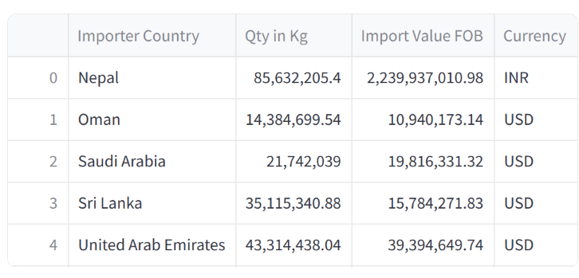
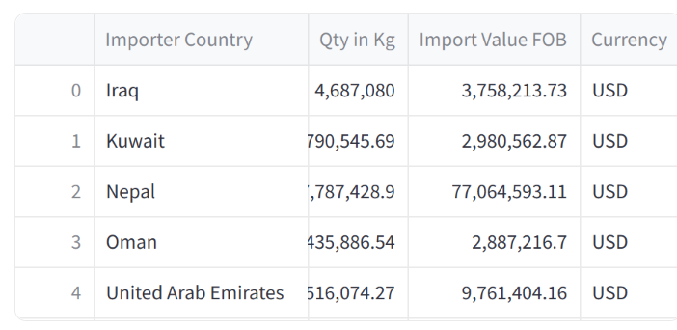
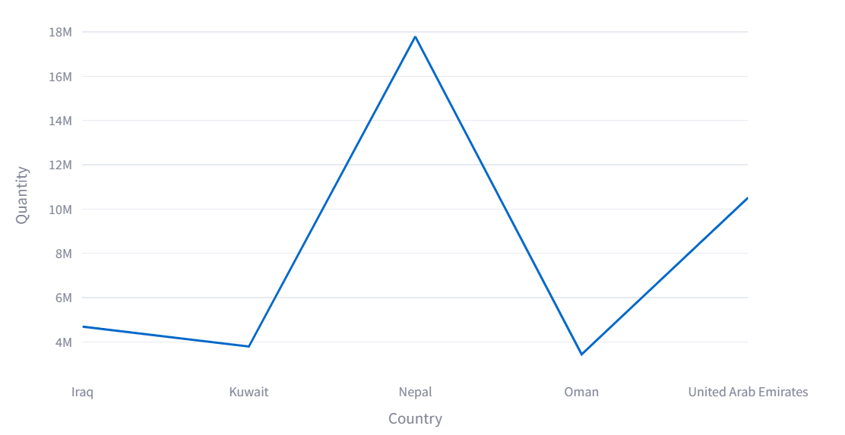
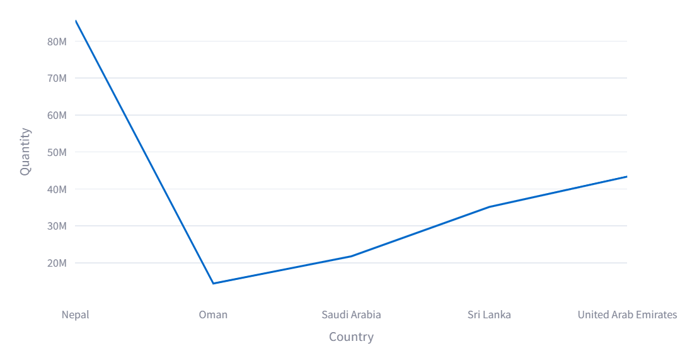
Import Overview
Top 5 Importer based on Qty – All Years
Top 5 Importer based on Qty – 2020

Slide 10
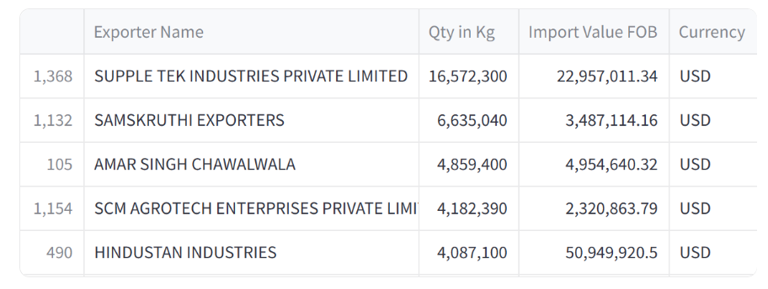
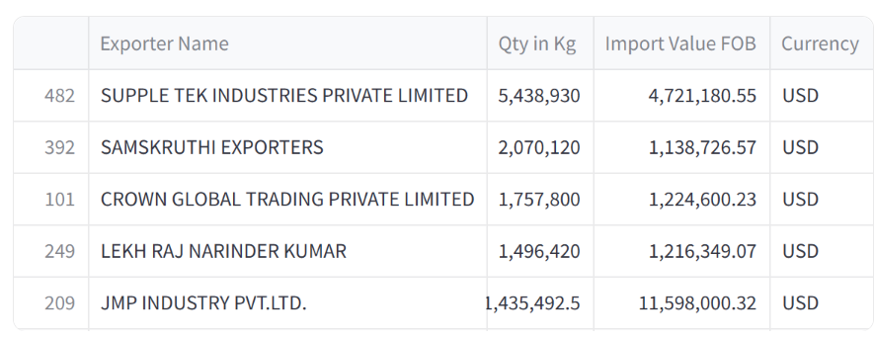
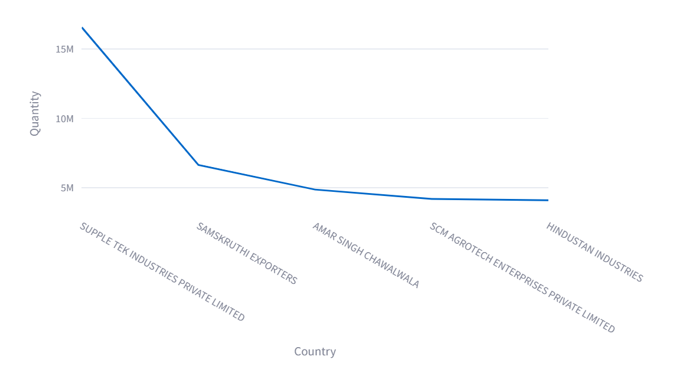
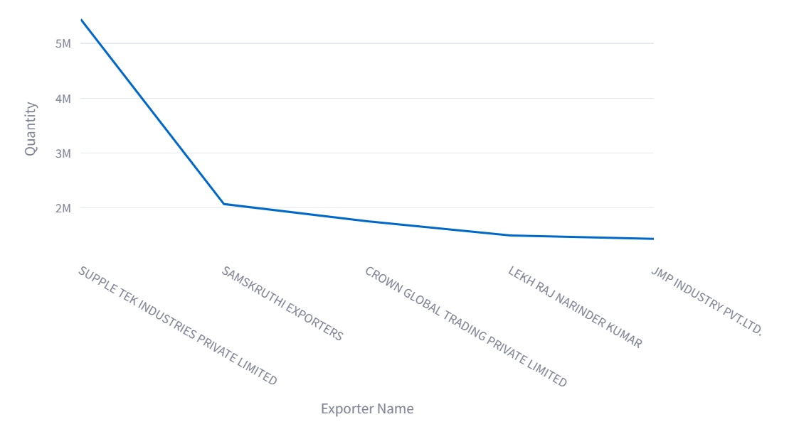
Export Overview
Top 5 Exporters based on Qty – All Years
Top 5 Exporters based on Qty – 2020

Slide 11
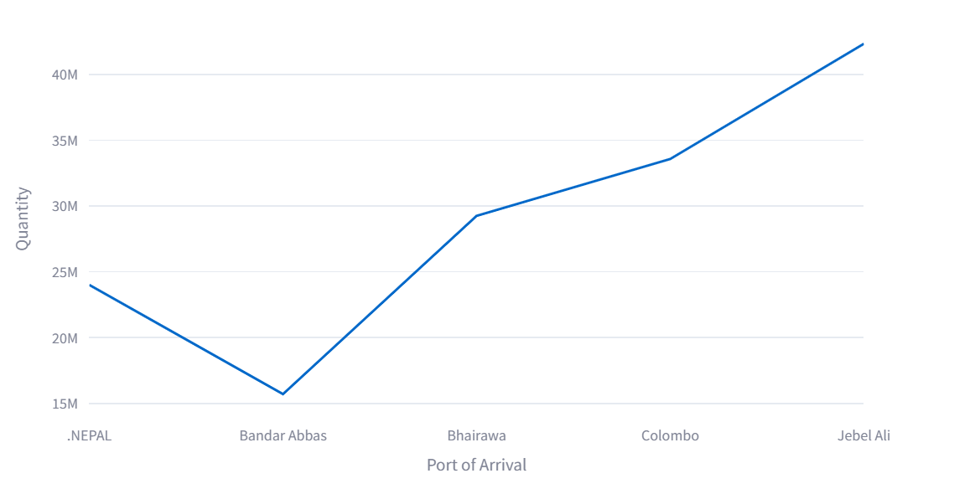
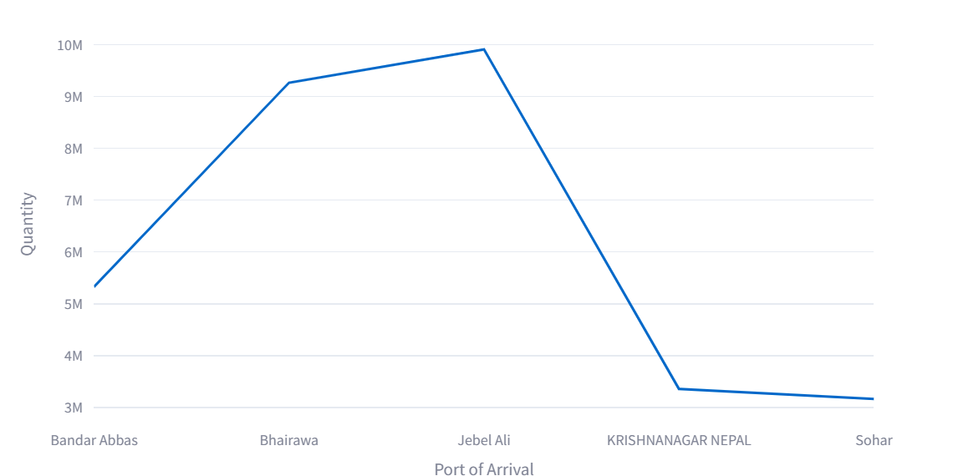
Port of Arrival / Departure Overview
Top 5 Exporters – All Years
Top 5 Exporters – 2020

Slide 12
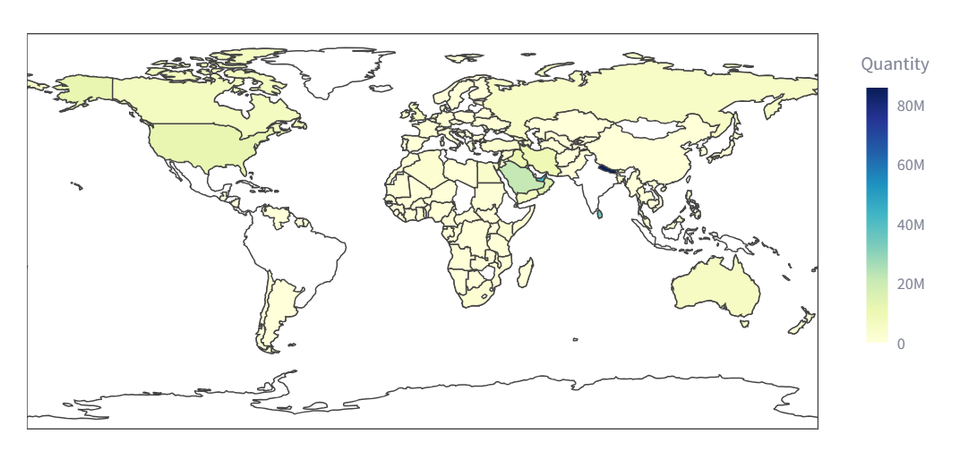
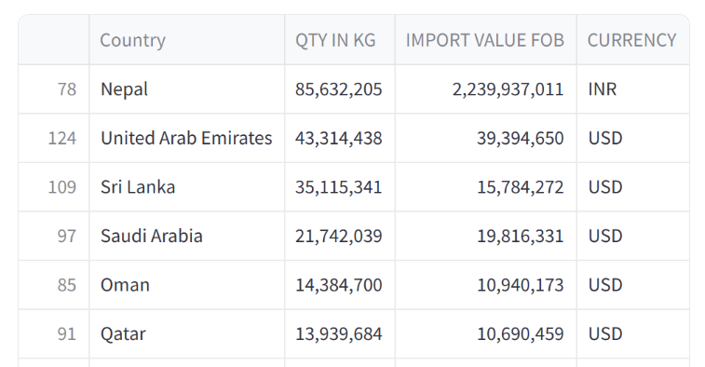
Geographical Analysis

Slide 13
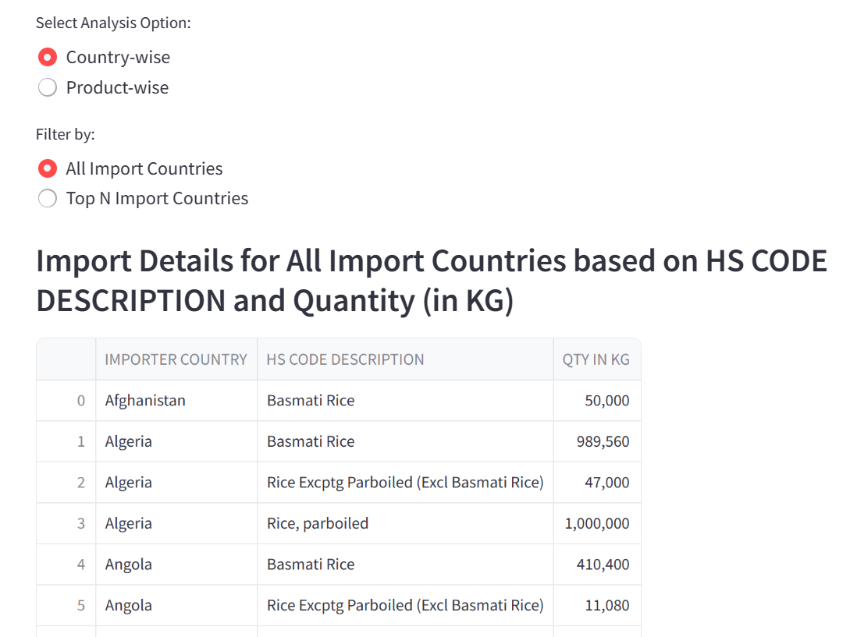
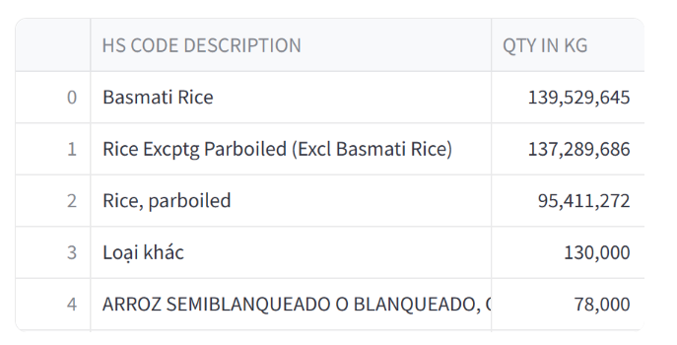
Product Analysis
Top 5 Products – All Years

Slide 14
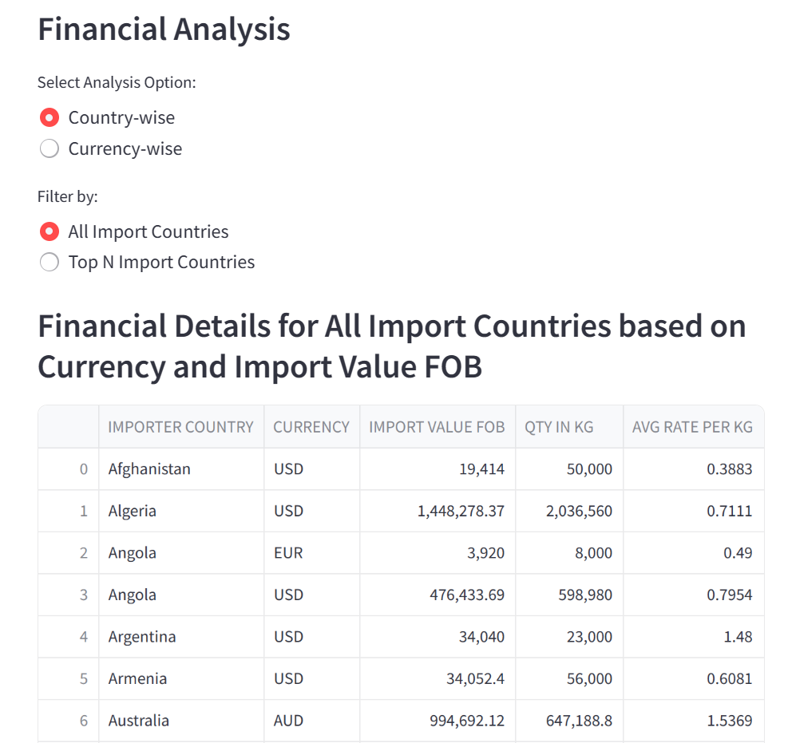

Slide 15
